Slide 1
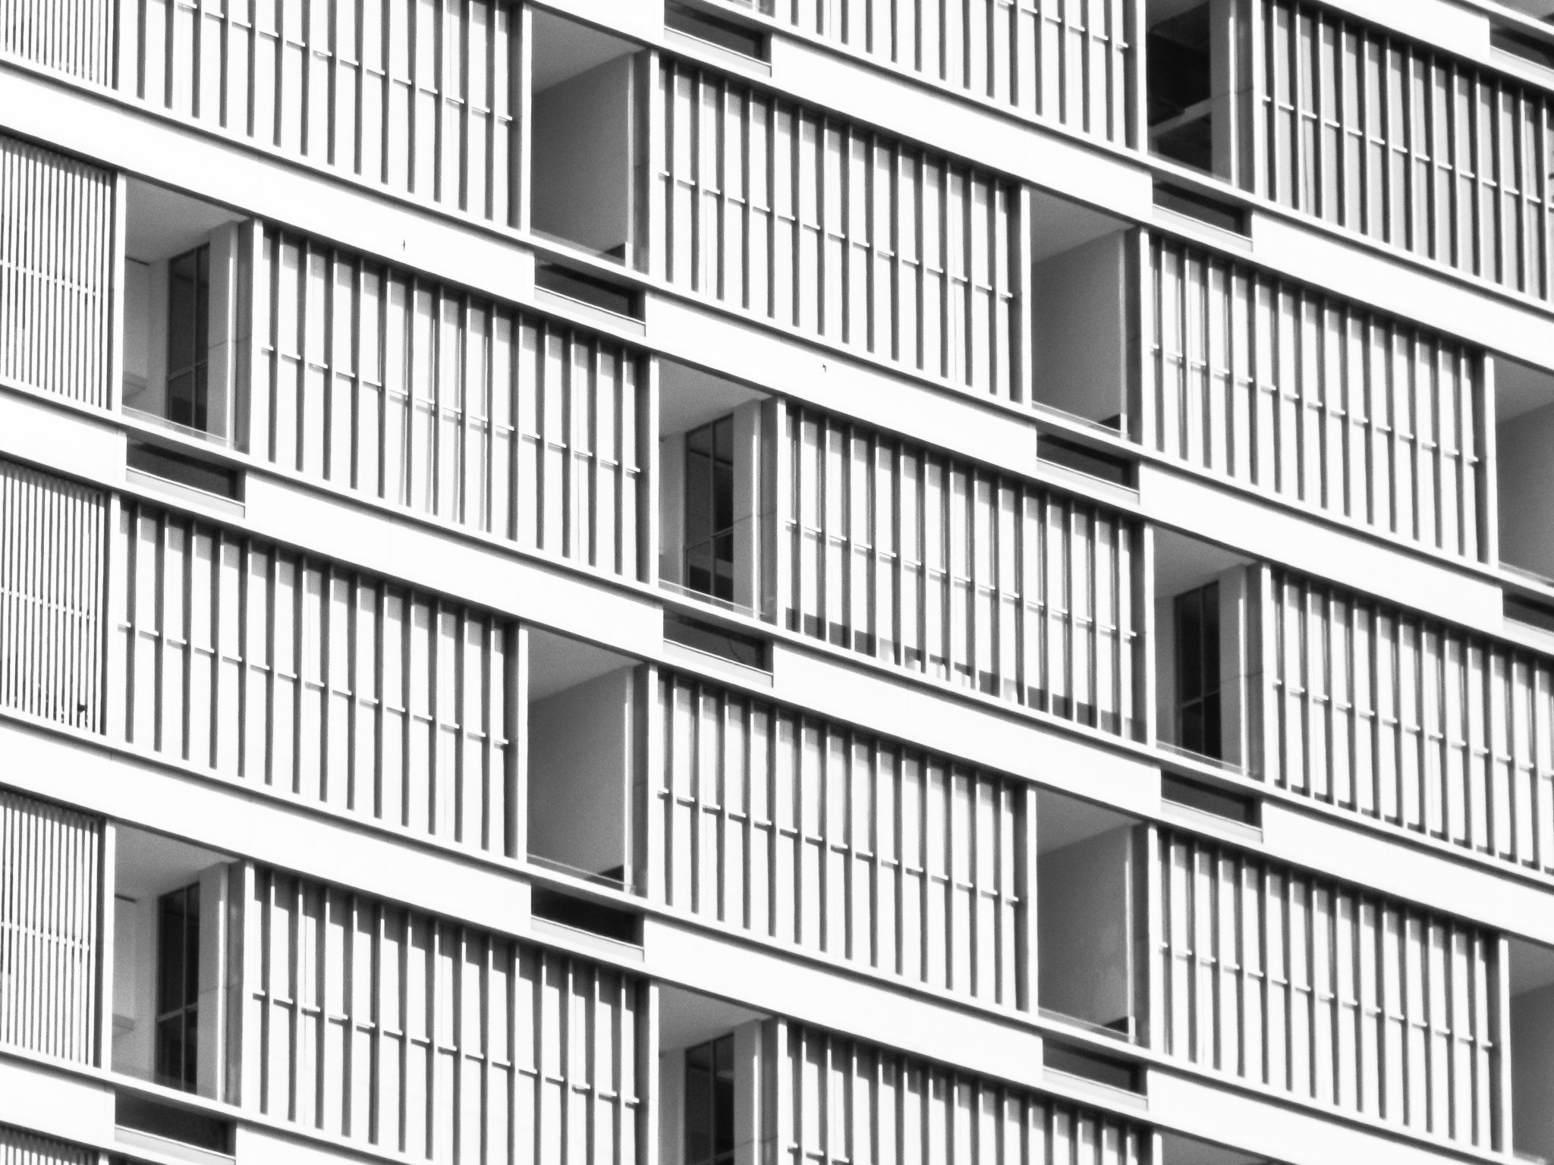
Building Violations Final Report
Team C:
Youxuan Ma, Guanxi Li,
Heyang Yu, Yuzhe Jiang, Jian Xie

Slide 2

Boston Building Violations Analysis
Objective:
Uncover patterns and trends in building violations across Boston, identifying hotspots and recurring issues that may require attention from urban planners and policymakers
Significance:
Building violations can impact community safety, property values, and urban development. By analyzing these violations, we aim to provide actionable insights that can help improve regulatory compliance and enhance living conditions in Boston

Slide 3
Analytical Approach and Methodologies
Analytical Techniques Used:
Descriptive Analytics: Initial exploration of data through summary statistics to understand the distribution and central tendencies of violation incidents.
Geospatial Analysis: Utilize geographic data to create heatmaps and location-based insights, which help visualize the concentration of violations across different neighborhoods.
Trend Analysis: Examine data over time to identify patterns or changes in the frequency of violations, which could indicate the effectiveness of policies or shifts in compliance behavior.
Clustering Analysis: Apply machine learning method to group categorical data.
Visualization Tools Employed:
Heatmaps: Used to identify high-density areas of violations and understand geographical distributions.
Bar Graphs and Pie Charts: Employed to present categorical data, such as the most common types of violations and the distribution across various streets and neighborhoods.
Python Libraries: Pandas for data manipulation, Folium for creating interactive maps, Matplotlib, and Seaborn for generating static visualizations, and etc.

Slide 4
Key Questions Addressed
Q1: Are there certain landlords / management companies that have repeated violations?
Q2: Are there common features of certain buildings?
Q3: What neighborhoods / communities are affected most?
Q4: What kinds of building complaints are people making around the city?

Slide 5
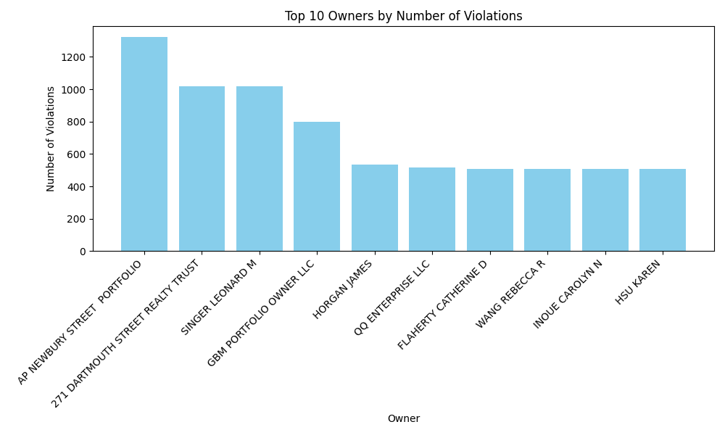
Insight 1: Repetitive Violations
Findings
Identified with a higher frequency of violations
- 'Ap Newbury Street Portfolio', '271 Dartmouth Street Realty Trust', and 'Singer Leonard M’
Implications
Suggests a potential focus area for regulatory bodies to enhance inspections and compliance checks
Serves as crucial information for potential tenants and real estate professionals regarding which properties might pose a higher risk

Slide 6
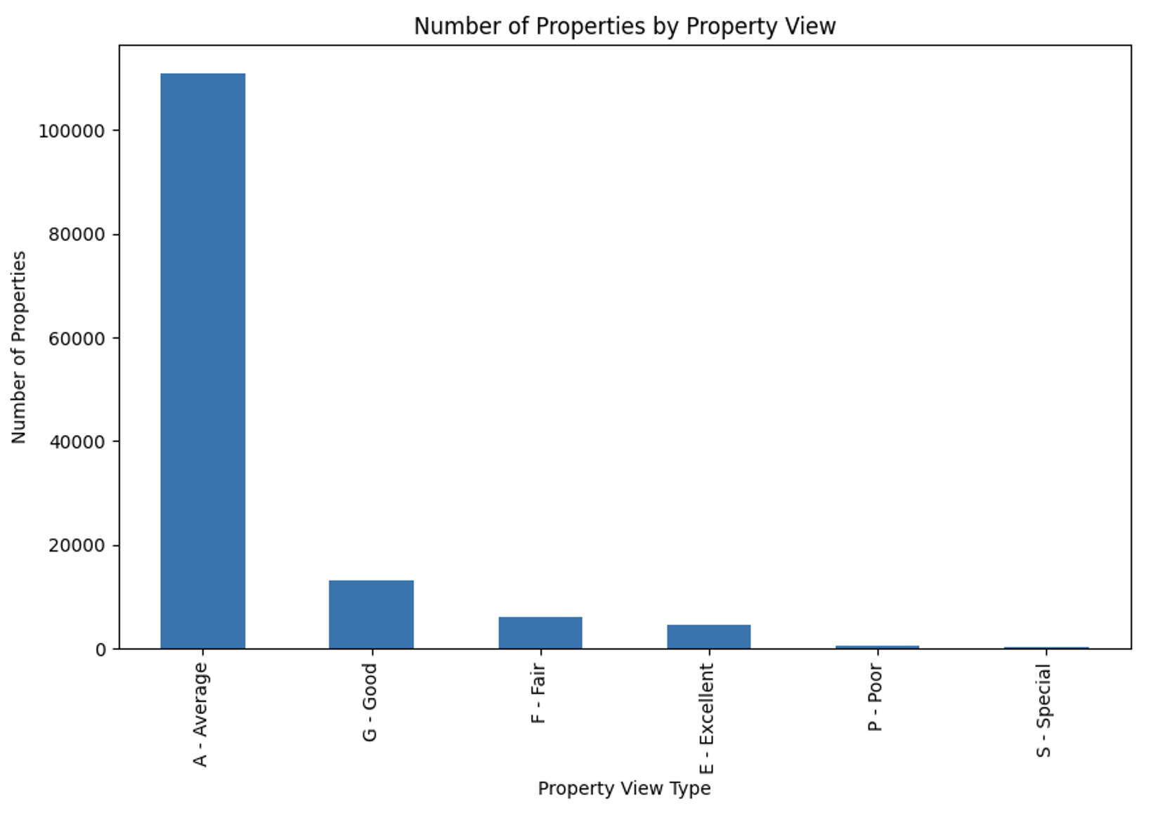
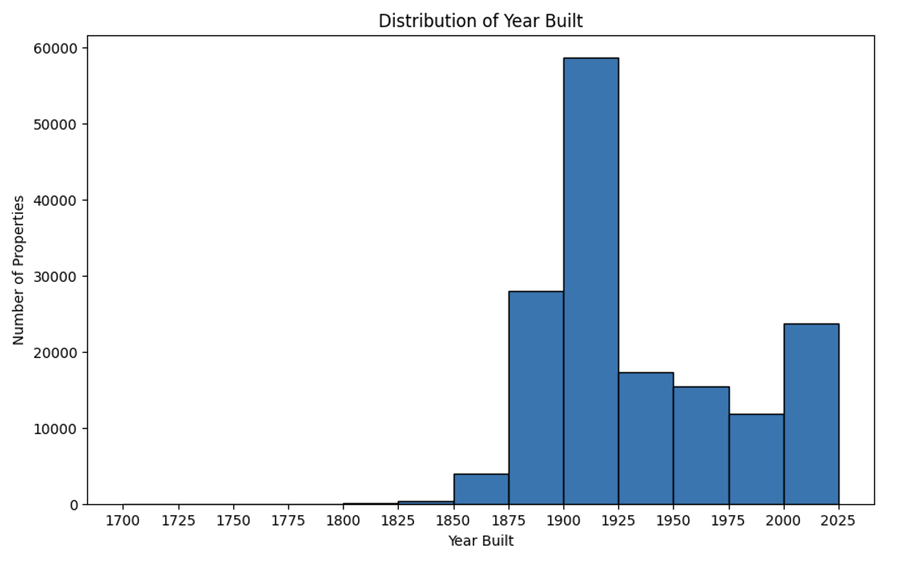
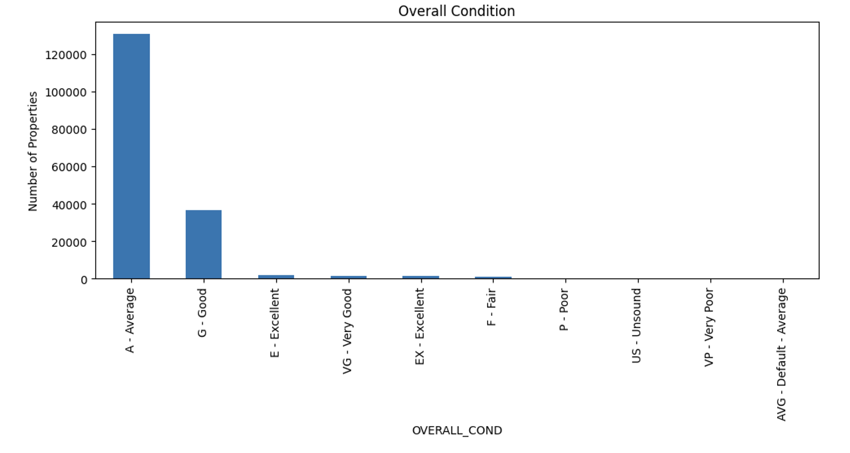
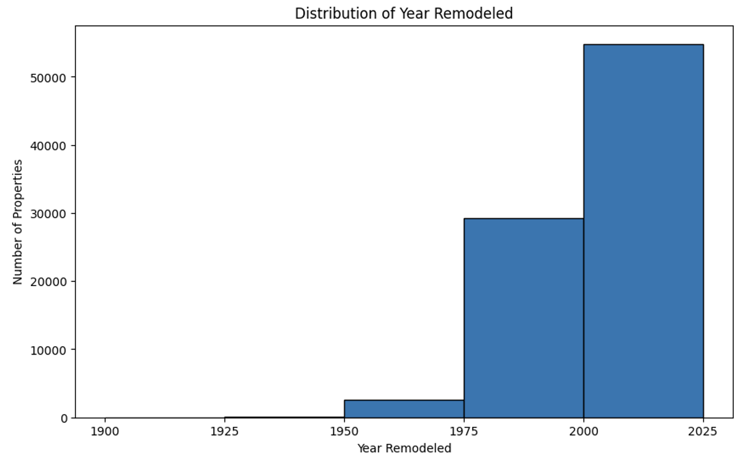
Insight 2: Common Features
Property View
Overall Conditions
Construction Year
Remodeling Year

Slide 7
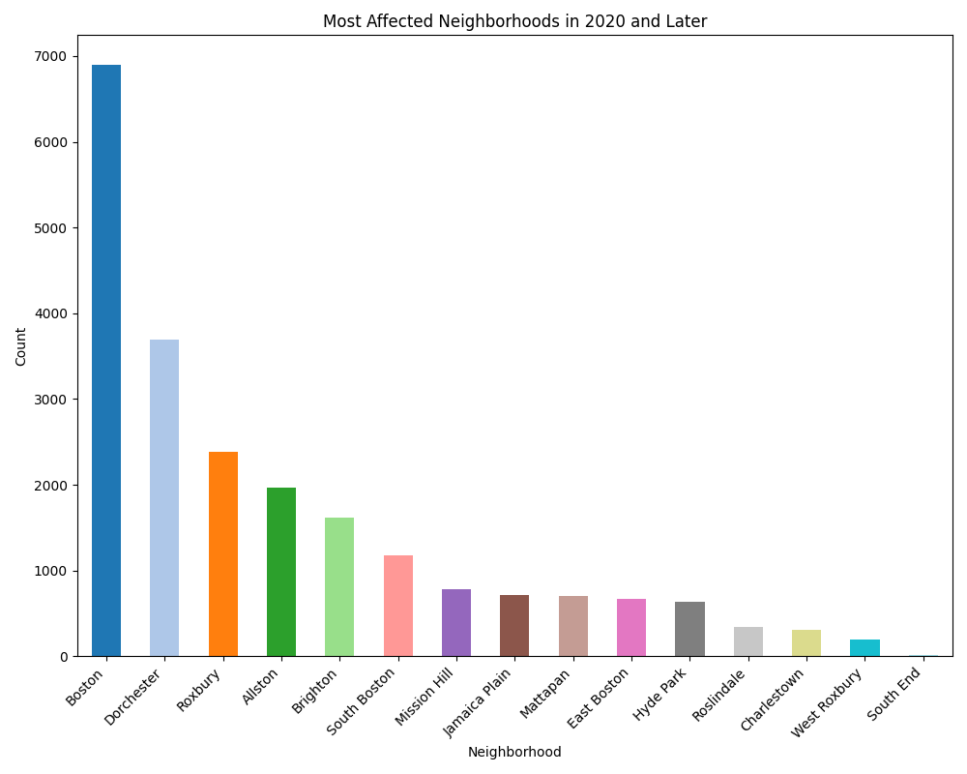
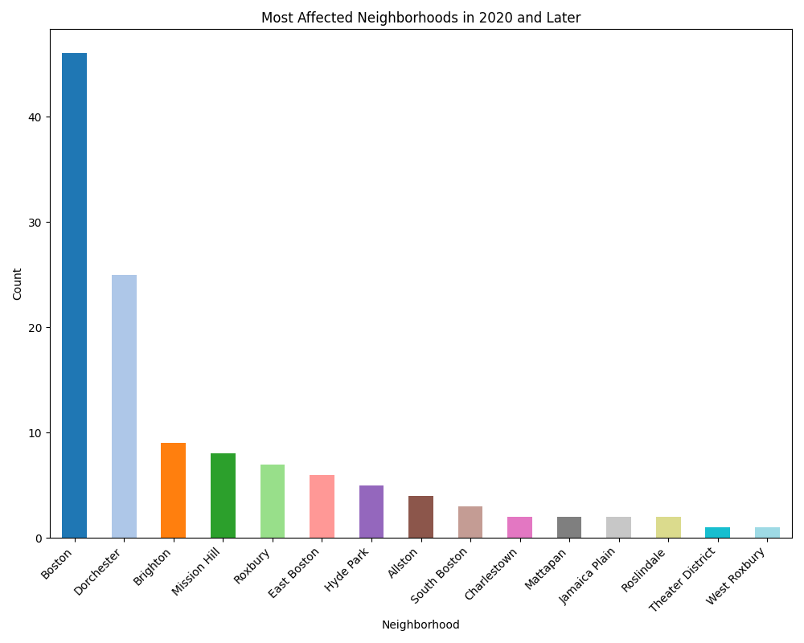
Insight 3: Most Affected Neighborhoods
Findings
Dorchester, Roxbury, and South Boston exhibit the highest number of building violations
Implications
These findings can guide urban planning and resource allocation, suggesting that interventions in these neighborhoods could significantly impact overall city compliance and community safety

Slide 8
Insight 3 Cont.
Selected the top 10 most common types of violations from each dataset
BUILDING_AND_PROPERTY_VIOLATIONS focuses on property owners' responsibilities
PUBLIC_WORKS_VIOLATIONS is more aligned with public safety and structural integrity

Slide 9
Property Numbers vs. Violations Cont.
For PUBLIC WORKS VIOLATIONS dataset
- Although Dorchester has the most properties and properties with violations, Chinatown has the highest violation rate, with over 12% of properties experiencing violations

Slide 10
Property Numbers vs. Violations Cont.
For BUILDING_AND_PROPERTY_VIOLATIONS dataset
Employing the same analysis process as before, the resulting graphs, sequentially, show the number of properties with violations and the ratio of properties with violations to total properties in each neighborhood
Dorchester leads in the number of properties with violations, but neighborhoods like Mission Hill, Chinatown, and Roxbury have the highest rates, with Mission Hill exceeding 60%. This indicates a higher likelihood of building violations in these areas

Slide 11
Key Takeaways
Overall, while the two datasets vary in scale and focus, the neighborhoods that rank high in violation rates are generally consistent across both datasets
The higher rates of violations in neighborhoods with fewer properties like Mission Hill suggest a higher risk of violations per property, which could be indicative of deeper underlying issues such as socio-economic factors or zoning regulations
This property analysis also shows that violation rates do not necessarily correlate directly with the number of properties

Slide 12
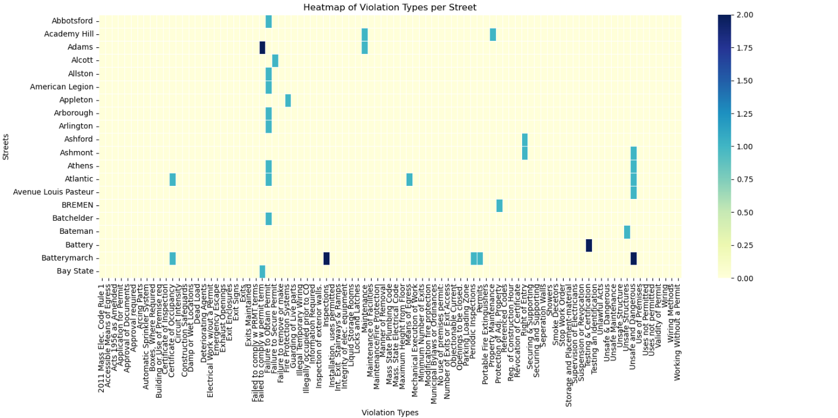
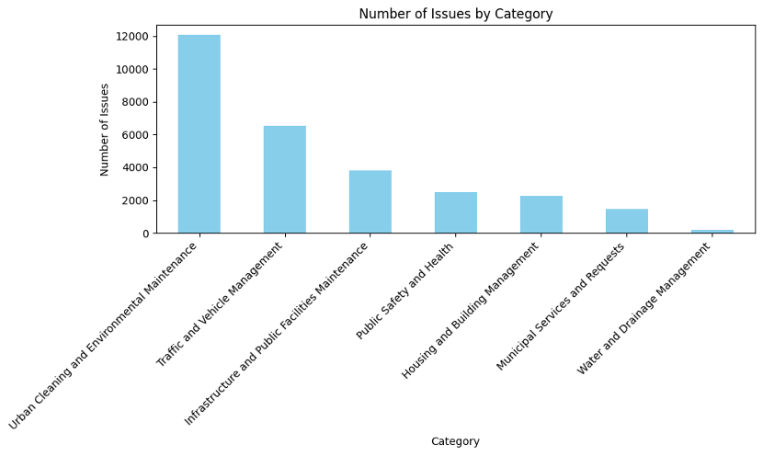
Insight 4: Main Complaints
Findings
The most common complaints are related to urban cleaning & environmental maintenance, traffic management, and safety violations such as faulty fire escapes and inadequate exit routes
Implications
Understanding the types of complaints helps in prioritizing which building codes need more stringent enforcement and where public awareness campaigns could be most effective. It also assists in tailoring preventative maintenance programs to reduce these violations

Slide 13

Further Explorations

Slide 14
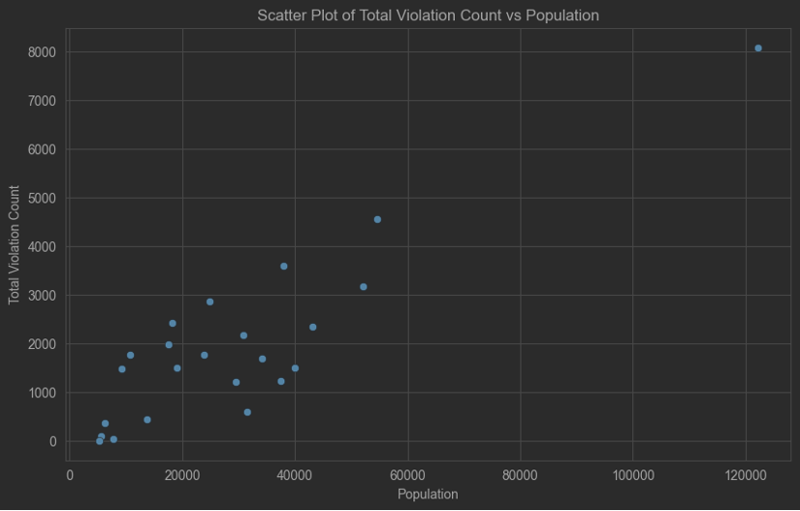
Insight 5: Population Size vs. Violations
Accurate population data is up to 2020
Would expect neighborhoods with larger populations to have more violations

Slide 15
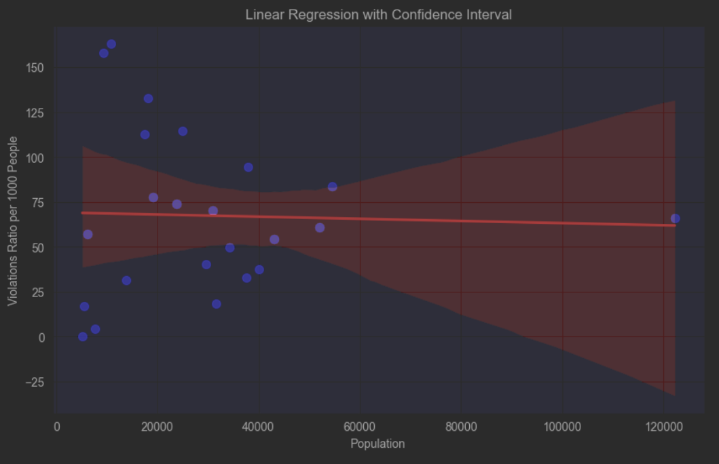
Population Size vs. Violations Cont.
It confirmed a general positive correlation
However, we found that this relationship is not significant, with no obvious trend and many data points falling outside the 95% confidence interval

Slide 16
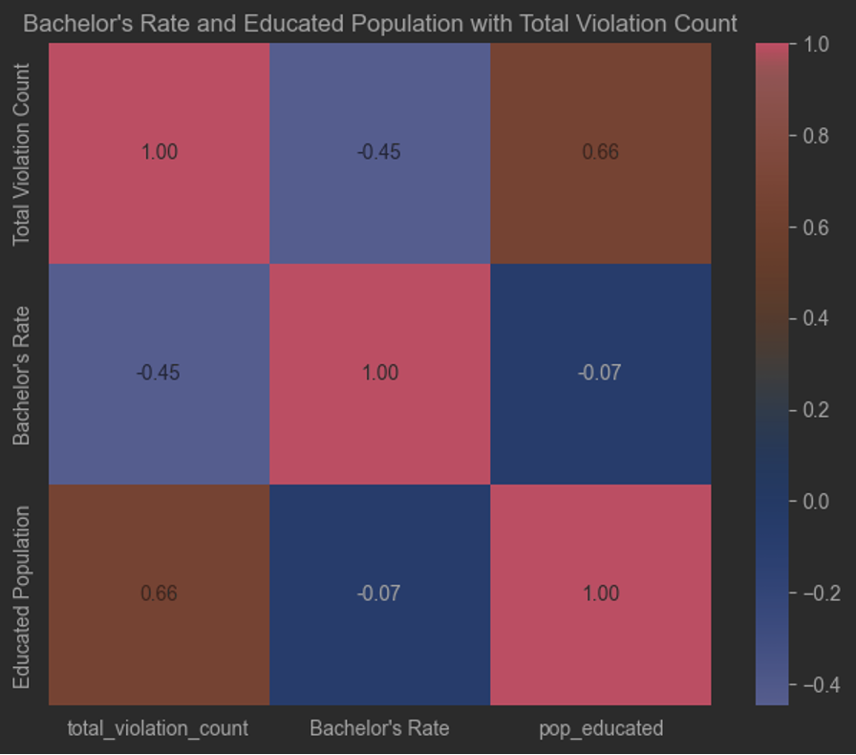
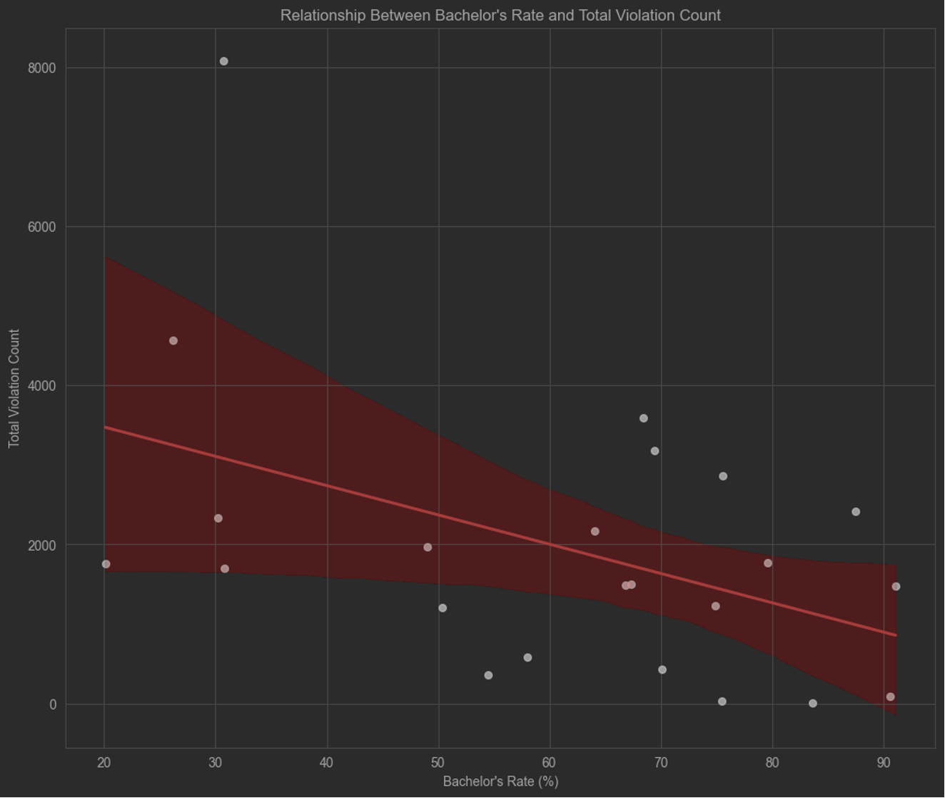
Insight 6: Education Level vs. Violation
Delved deeper into residents with "well-educated" population using heatmaps and linear regression results
There is a negative correlation of -0.45 between the proportion of well-educated residents and violations
Employing linear regression, over 50% of the data points fall within the 95% confidence interval, indicating a certain negative correlation between education level and violations

Slide 17
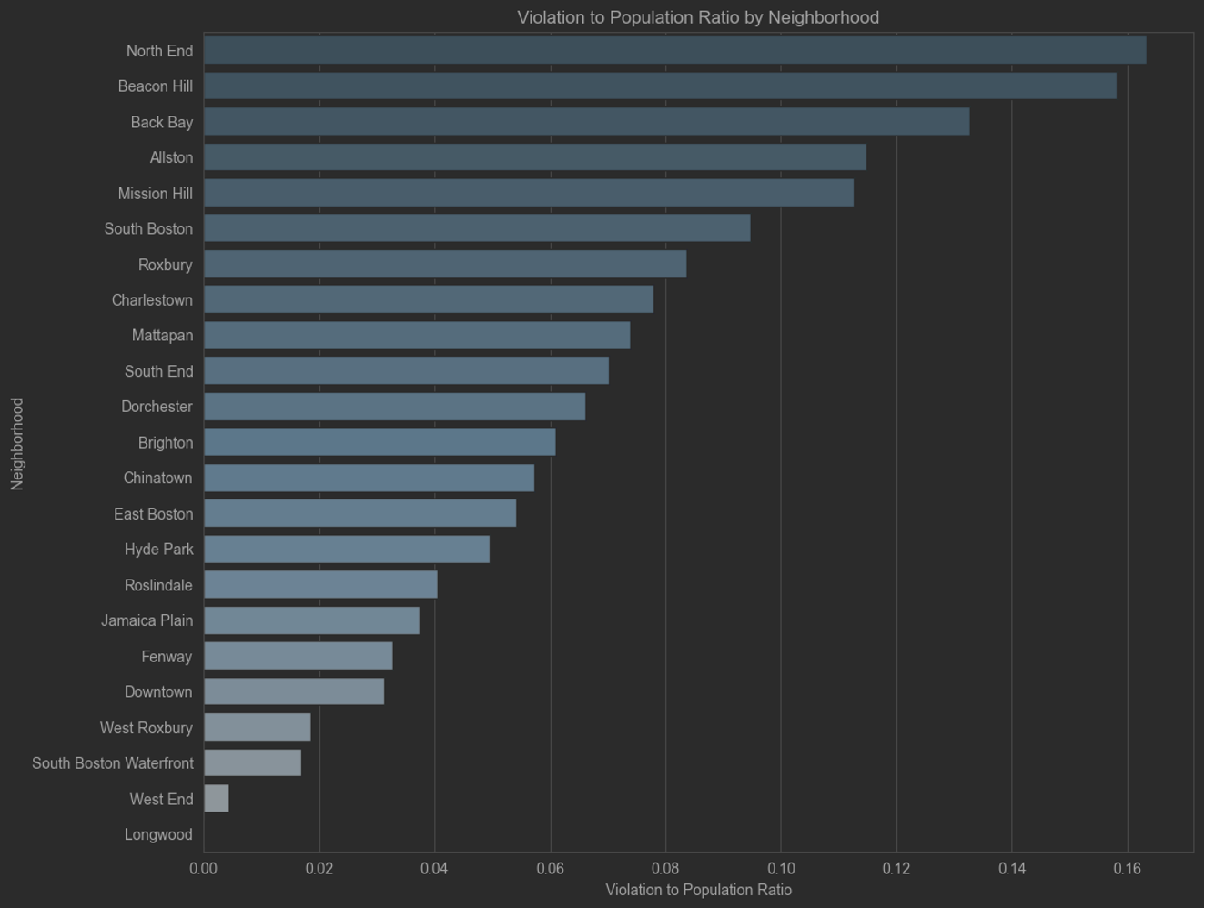
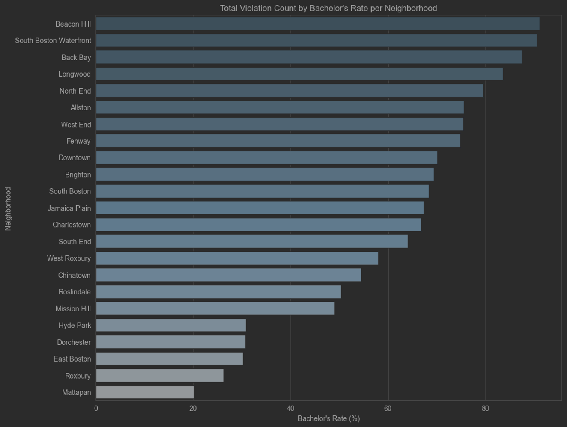
Education Level vs. Violation Cont.
Illustrate the bachelor's degree rate by neighborhood, showing Beacon Hill with the highest rate exceeding 85%, while Mattapan has the lowest, around 20%
Notably, despite Beacon Hill having the highest education rate, it also has the second highest number of violations per capita
Conversely, Dorchester, with the highest population and number of violations, ranks below fourth from the bottom in terms of education level

Slide 18
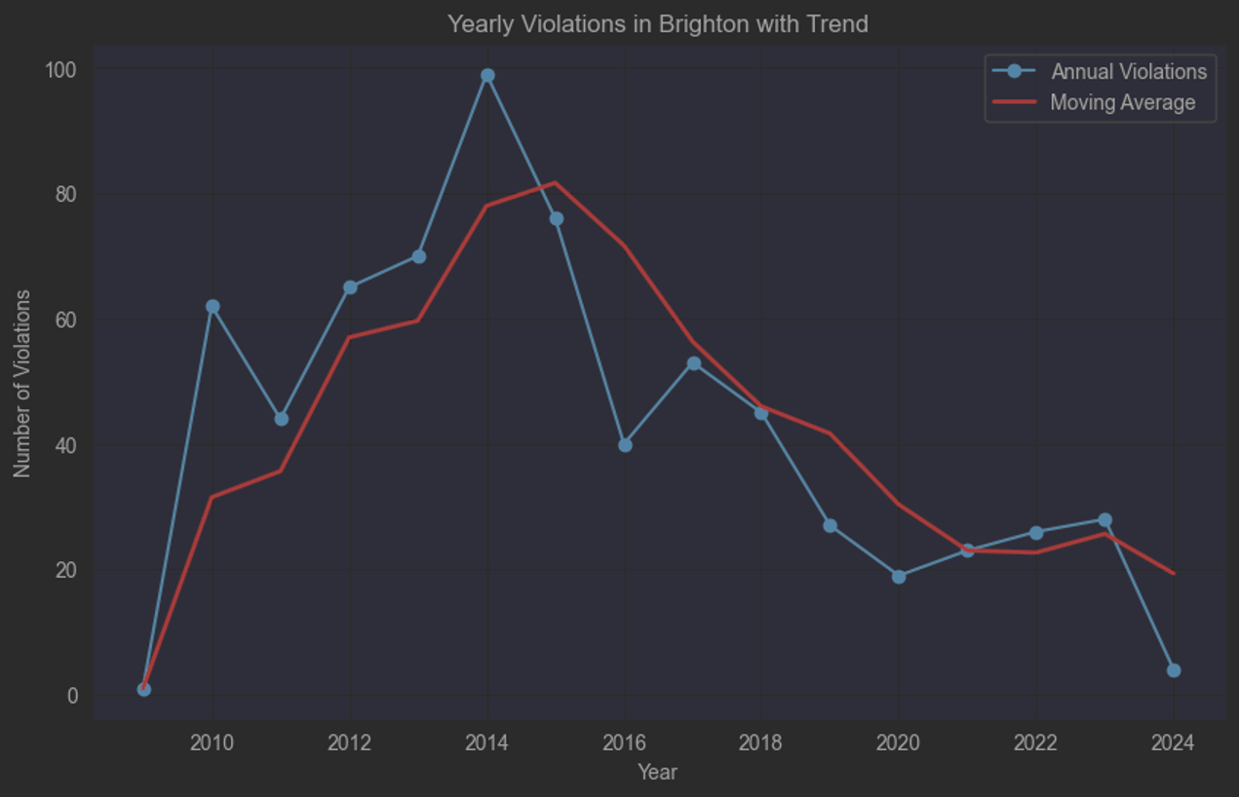
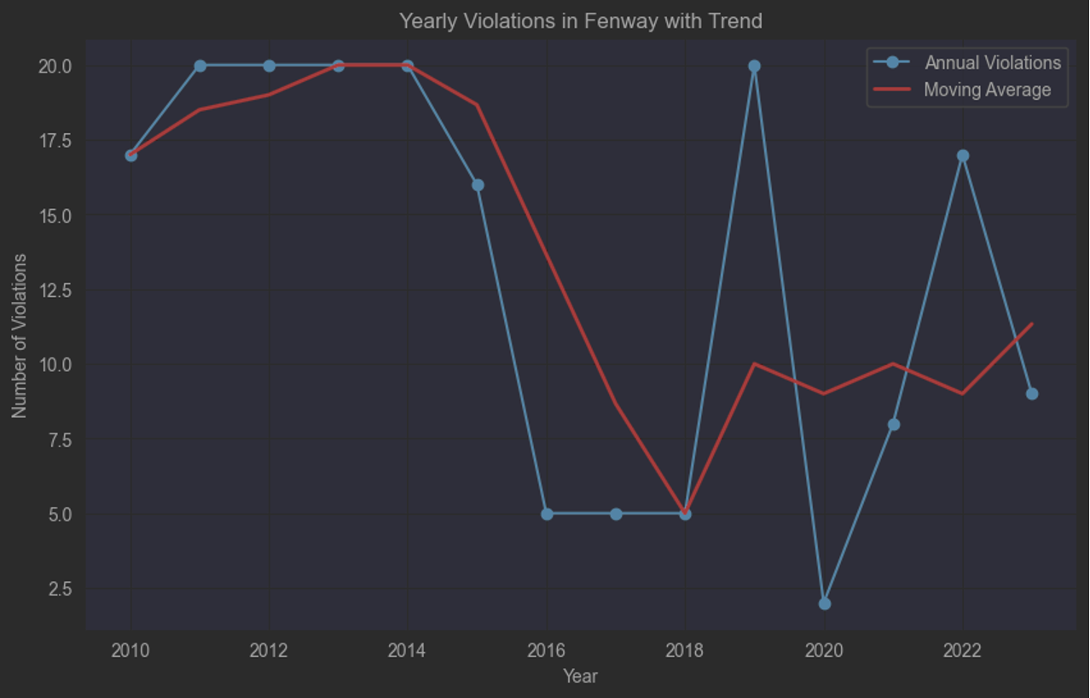
Insight 7: Time-based Analysis of Violations
Same as Q3, we selected the top 10 most common types of violations from BUILDING_AND_PROPERTY_VIOLATIONS which focuses on property owners' responsibilities and PUBLIC_WORKS_VIOLATIONS which is more aligned with public safety and structural integrity
PUBLIC_WORKS_VIOLATIONS: recorded the number of violations per neighborhood annually and observed trends from around 2010 to 2024
Each neighborhood showed a trend of initially rising and then declining, resembling a hill, but the peak years varied

Slide 19
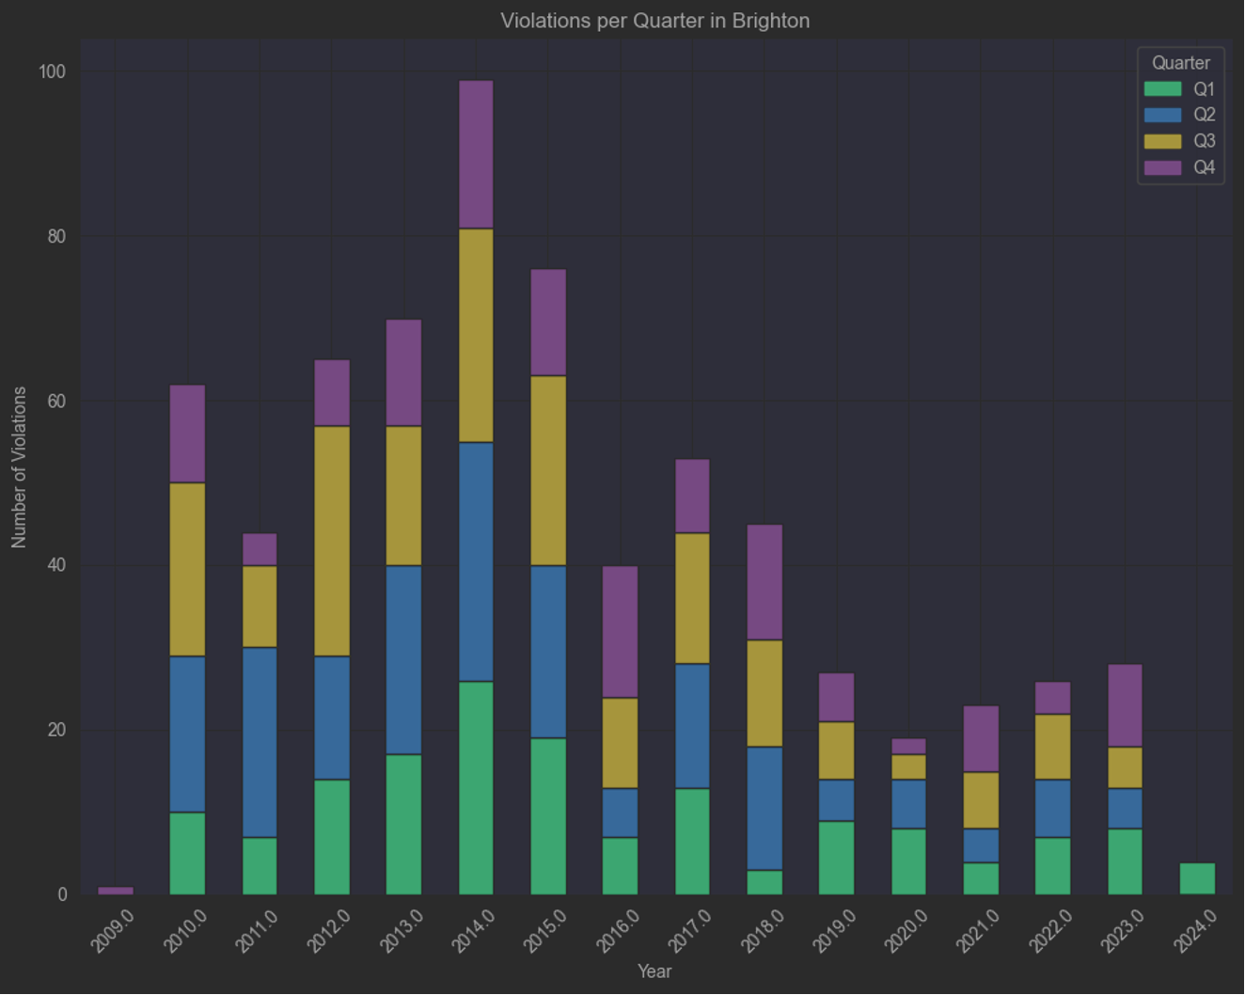
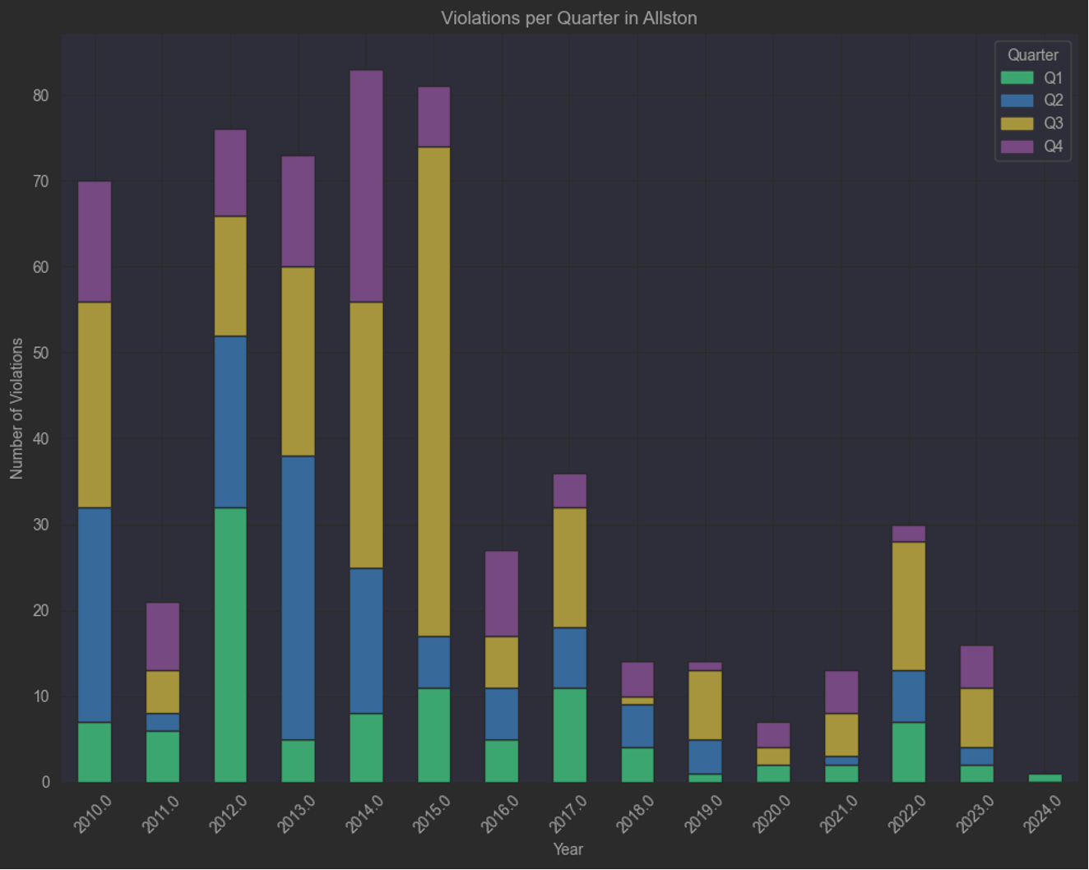
Quarters of the Year vs. Violations
Explored the relationship between seasons and violations
Each neighborhood displays unique characteristics, and there is no consistent trend applicable to all neighborhoods

Slide 20
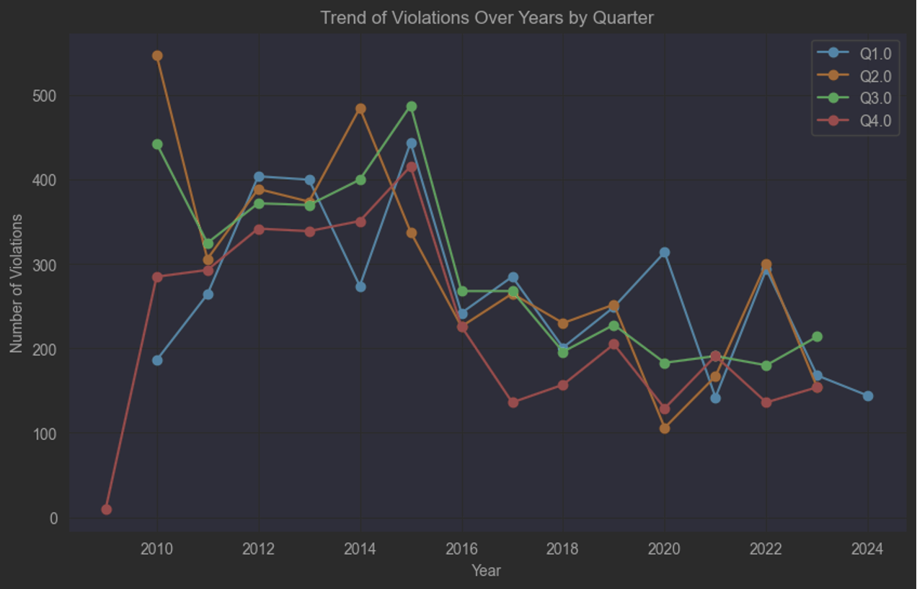
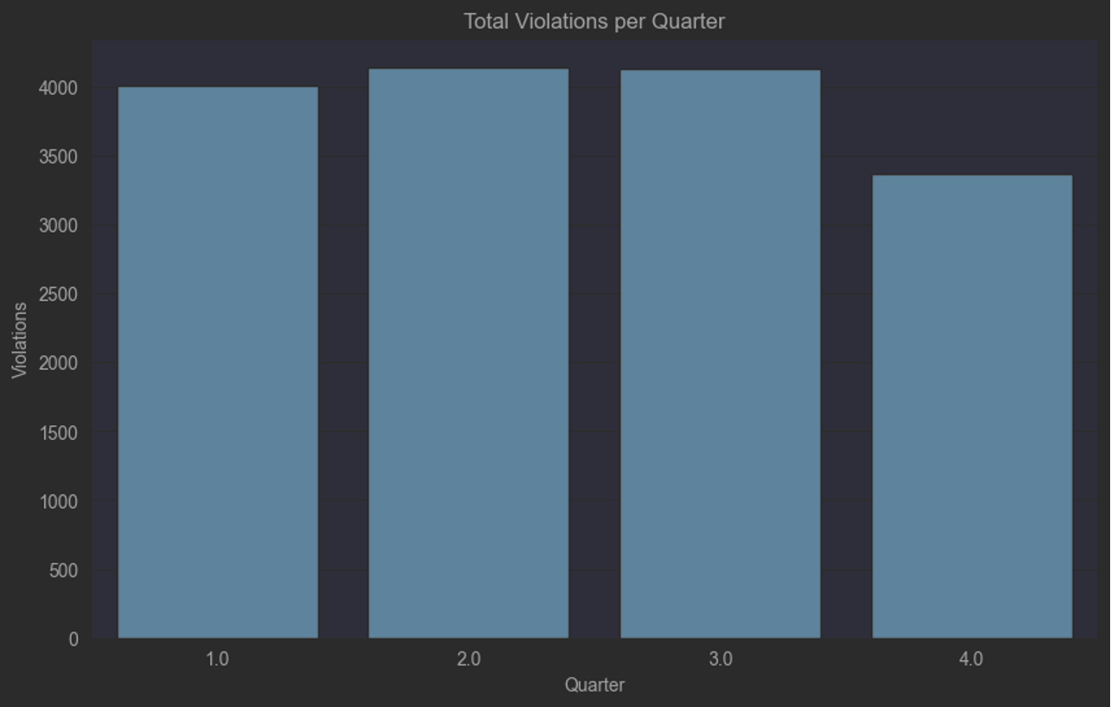
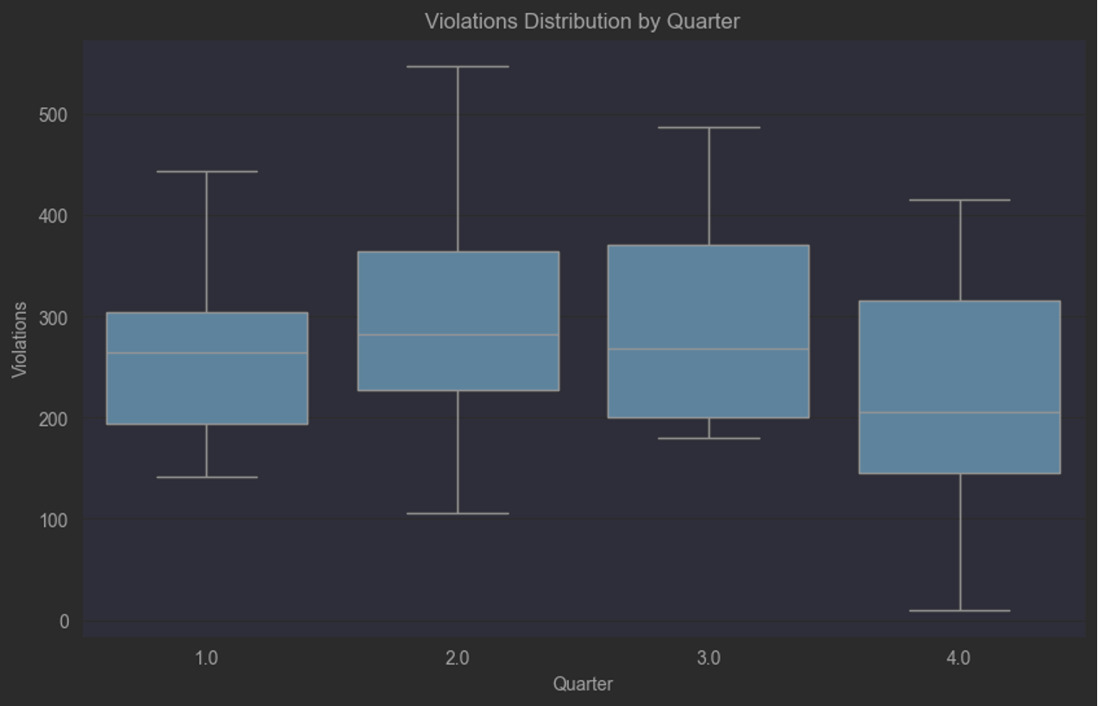
Analysis by Quarter Cont.
Explored the overall case by quarter: the second and third quarters have slightly higher median violation numbers and quartile ranges than the first and fourth quarters
Overall violations are declining, but each quarter has had years when it led in numbers, showing that no certain quarter is consistently prone to more violations

Slide 21
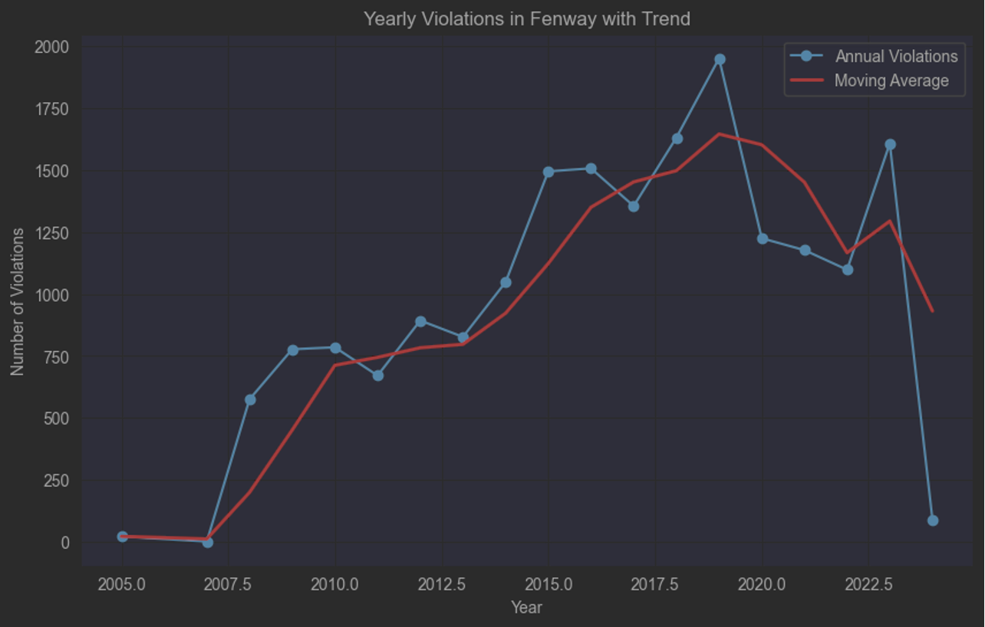
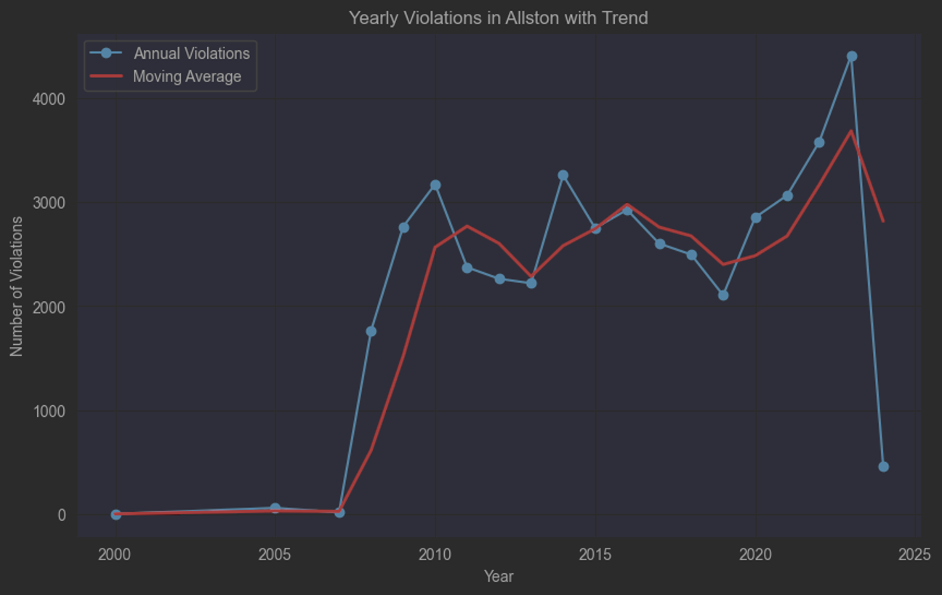
Temporal Analysis Cont.
A similar analysis as before for BUILDING_AND_PROPERTY_VIOLATIONS
This dataset indicates an increasing trend in the number of violations across most neighborhoods from 2015 to 2020 which differs with the last dataset
Specifically, Allston and Fenway have seen a steady increase in violations over recent years.
This trend could likely be associated with changes in regulatory enforcement or other external factors affecting these areas.

Slide 22
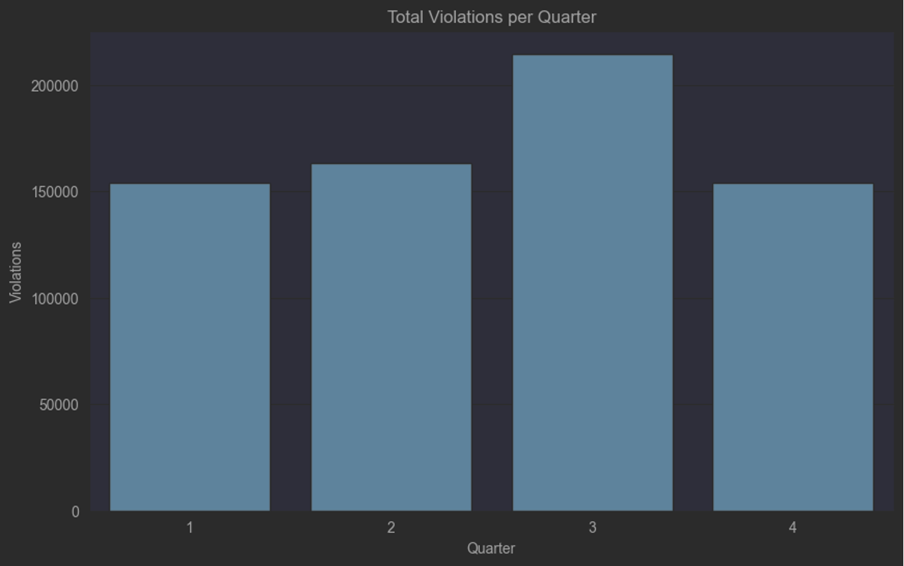
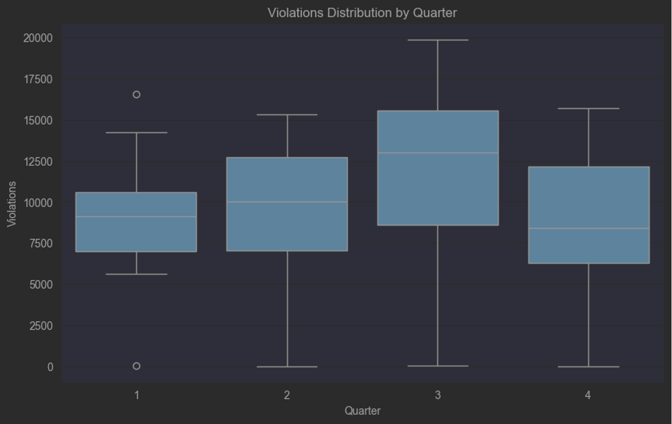
Quarters of the Year vs. Violations
Explored the relationship between quarters and violations: the number of violations in the third quarter exceeds the other three quarters
Suggests that issues such as property maintenance, cleanliness, and compliance with city ordinances are more likely to occur in the third quarter
May be closely related to the moving season associated with the start of the academic year

Slide 23
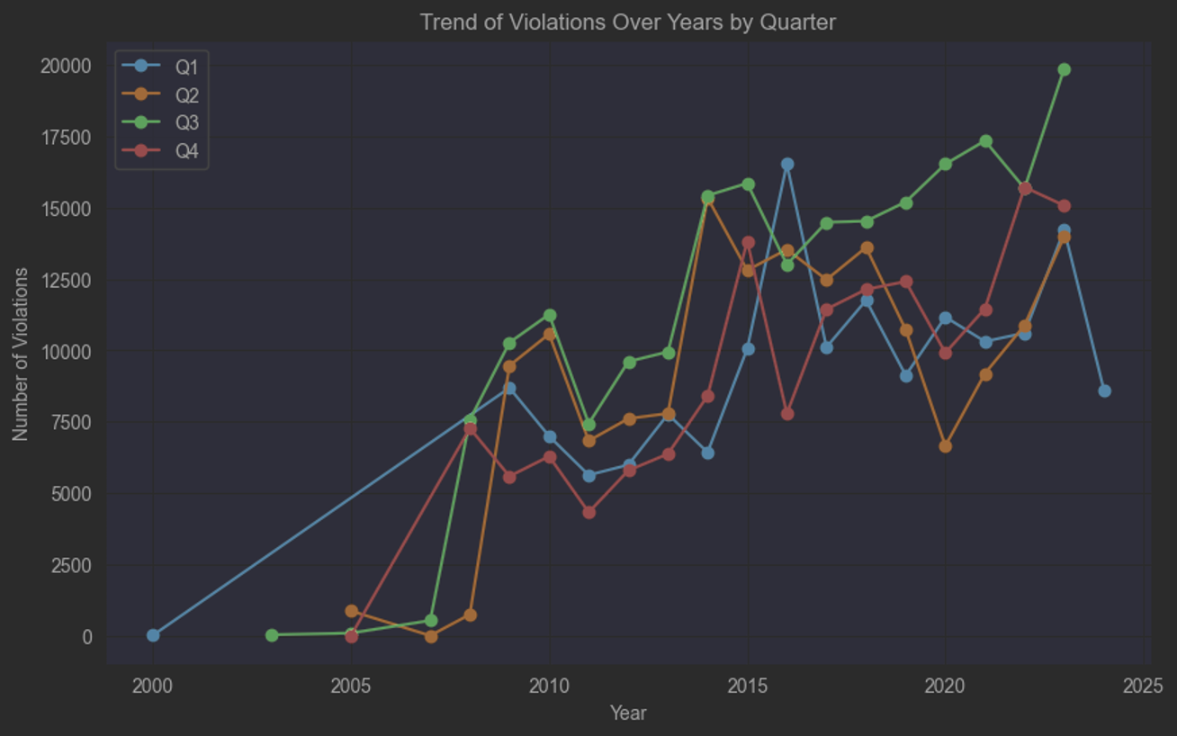
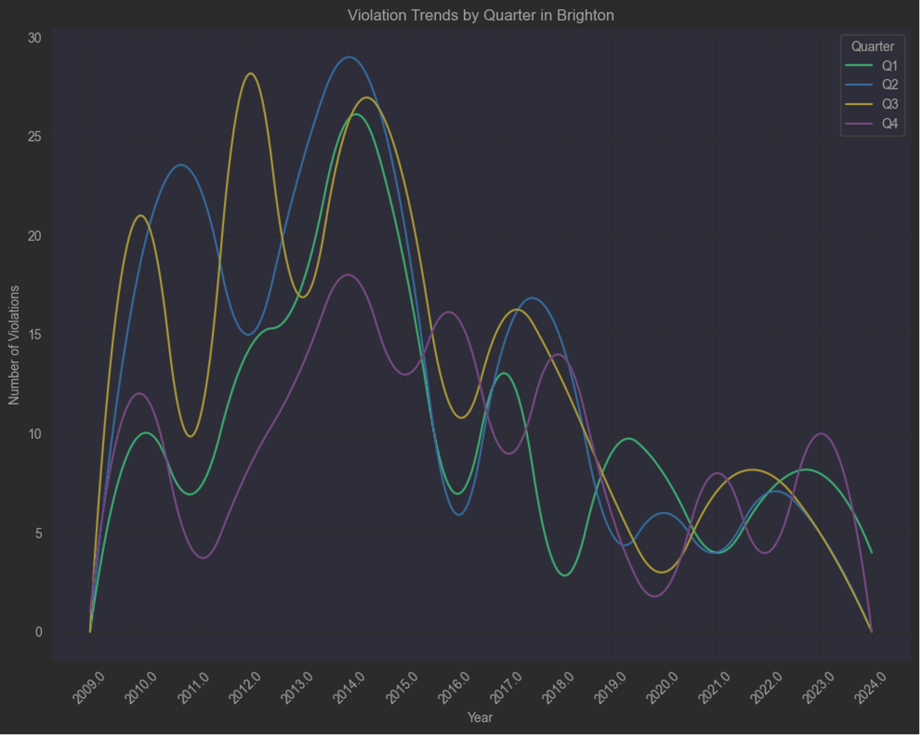
Analysis By Quarter Cont.
Left one shows the third quarter is gradually becoming the quarter with the most violations
The right shows the situation in each neighborhood is chaotic and lacks clear characteristics

Slide 24
Economic Influences on Violations
Extend our focus on deciphering the economic dimensions that may influence the incidence of building violations in Boston - the interconnections between rental costs, resident income levels, and their collective impact on housing violations
Primary hypothesis - higher rent indices correlate with better housing quality, hence lower violation frequencies
Conversely, we surmise that lower household incomes could be associated with increased violation rates due to potential constraints on housing maintenance and quality of living conditions
We sourced our rental data from Zillow’s Observed Rent Index (ZORI), which provides a comprehensive view of the typical market rent. For income statistics, we utilized data from incomebyzipcode.com

Slide 25
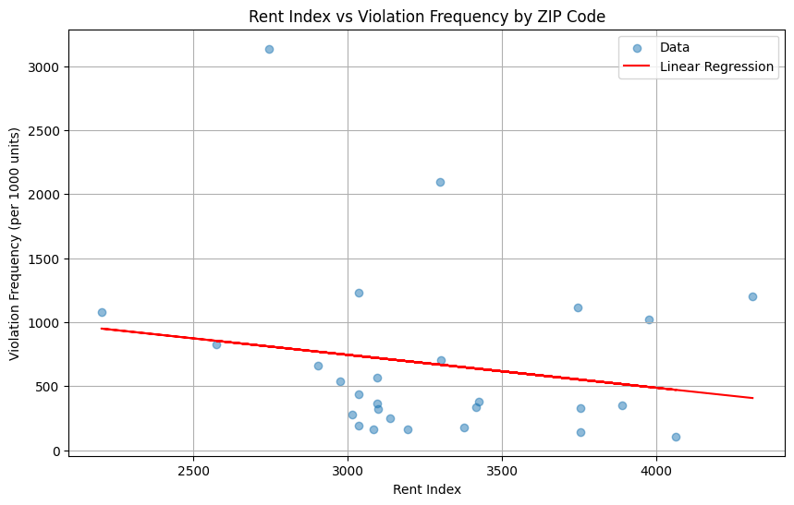
Insight 8: Rent Index vs. Violation Frequency
Rental Index:
Zillow’s Observed Rent Index (ZORI) serves as our proxy for housing quality. It is a weighted average designed to reflect the rents of all properties in the market, smoothing out the extreme values
Violation Frequency:
Calculated per 1,000 residential units to ensure comparability across zip codes with varying numbers of residential properties
Linear Regression Findings:
Our linear regression model reveals a downward trend line
Statistical Interpretation:
While the overall trend supports our hypothesis, the presence of outliers signifies the influence of additional factors

Slide 26
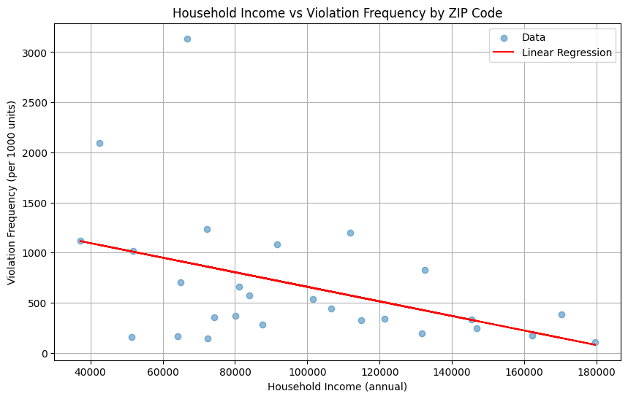
Insight 9: Household Income vs. Violation Frequency
Used the median household income data to construct a socio-economic profile for each ZIP code. Then juxtaposed this data with violation frequencies to investigate potential economic disparities
Regression Analysis Insights:
The linear regression model depicted in the accompanying graph demonstrates a clear negative correlation
The slope of our regression line is negative, and most data points fall close to this line, indicating a strong relationship between income levels and housing violation frequencies
Contextual Analysis:
This inverse relationship may be indicative of higher-income households having more resources for property upkeep and adherence to housing regulations, thereby reducing the likelihood of incurring violations
Nonetheless, the trend's outliers suggest that income is not the sole determinant of housing conditions

Slide 27
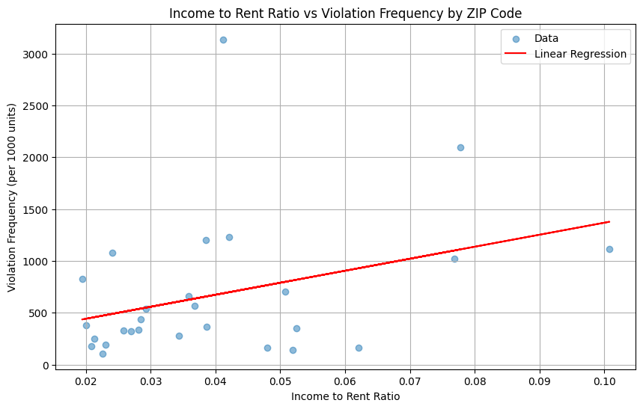
Insight 10: Income to Rent Ratio vs. Violations
Delving deeper, beyond absolute income levels, we examined the proportion of income that households allocate towards rent, hypothesizing that a lower income-to-rent ratio may correspond to a lesser likelihood of housing violations, reflecting better living conditions and maintenance capacity.
Our regression model indicates a positive slope, suggesting that as the proportion of income spent on rent decreases, the frequency of violations per 1,000 units also diminishes.
This relationship, while present, is not as pronounced as the income-violation correlation, signaling that affordability plays a role, but its influence is subtler.
A lower income-to-rent ratio may indicate more disposable income for home maintenance and investment in living conditions, which could contribute to compliance with building standards. However, the modest slope of the trend line and the variability among data points remind us that affordability is one piece of a larger puzzle.

Slide 28
Economic Influence Takeaways
Key Insights:
Areas with higher Rent Index values, reflecting higher rents, generally report fewer violations per 1,000 units, suggesting better housing quality and maintenance.
Higher household incomes are associated with lower rates of violations, indicating that economic prosperity could translate into improved housing conditions and compliance.
The Income to Rent Ratio, while less pronounced, still underscores the importance of affordability and disposable income in the context of housing quality.
Policy Implications:
The data informs us that interventions aimed at improving housing conditions and reducing violations should be socio-economically sensitive, targeting not just the physical infrastructures but also the economic realities of residents.
Policies could include targeted subsidies for housing maintenance in lower-income areas, incentives for landlords to improve property conditions, and community-based initiatives to raise awareness about housing standards.

Slide 29
Conclusion
Base questions recap with revises
Create metrics of # of violations compared to # of units
Keep boundaries clear in heatmaps
Extension - three parts
People Relation: Population → Education Level
Time-based Analysis: Quarters of the Year
Economic Influences: Rent Index, Household Income and Income to Rent Ratio
Q & A

Slide 30
Thanks for watching!

